Slide 1
PersonCRUD using C#, xUnit and Dapper
By Nicholas Browning

Slide 2
Agenda
What is the project?
Slide by Slide demo
Entity Framework vs Dapper
What is Unit and Mock testing?
My experience with xUnit and Moq testing

Slide 3
What is the project?
The project is Dashboard UI which incorporates the ability to create, read, update and delete people.
The project was solved using C# and SQL. The SQL server was MSSQL and
Testing was solved using xUnit and Moq testing.

Slide 4
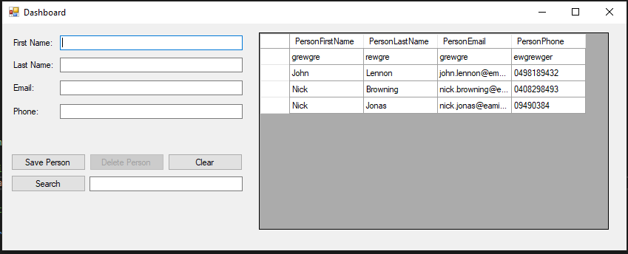
Slide by Slide demo

Slide 5
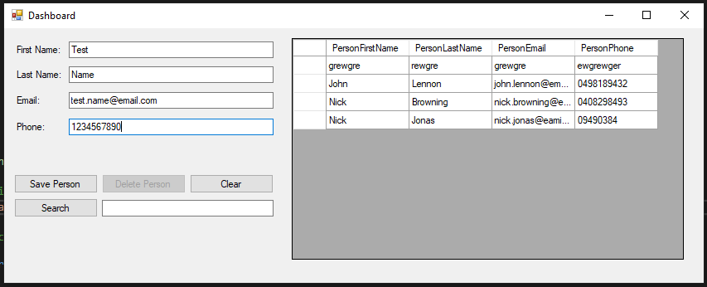
Slide by Slide demo

Slide 6
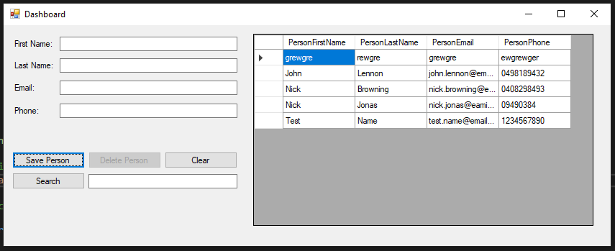
Slide by Slide demo

Slide 7
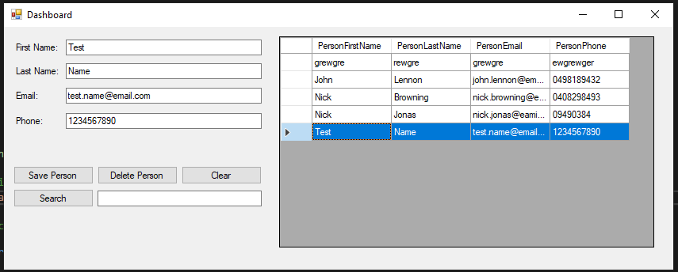
Slide by Slide demo

Slide 8
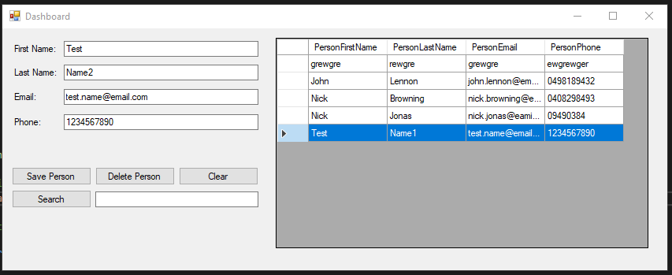
Slide by Slide demo

Slide 9
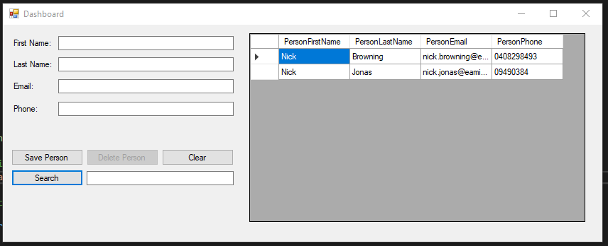
Slide by Slide demo

Slide 10
Entity Framework vs Dapper
 | Entity Framework | Dapper
Similarities | Both are ORMs (Object Relational Mapping) which are techniques used to let you query and manipulate data from a database. Both are C# libraries and .NET programming tools.
Differences | Entity Framework is a full-featured ORM while Dapper is a micro ORM (lack of powerful features). Dapper does not have migration features.
Pros | Auto-generated code. Reduces time and cost during development. Visual representation of database mapping. | Performs faster. Easier to correct parameterize queries. More suited for complex projects.
Cons | The auto-generated code can not be controlled. Runs poorly with larger domain models. | You have to design your own queries. Can turn off developers who are used to a code-first environment.

Slide 11
What is Unit and Mock Testing
Unit Testing | Mock Testing
Software testing where individual components of software is tested. Isolates a section of code and verifies its correctness. Fixes bugs during the development phase. Helps developers understand their code including its functionality and enables the developer to make quick changes to their code. | Simulated objects used to mimic real objects with rules and constraints. A mock object is created to test the behaviour of an object. Isolates testing from real objects.

Slide 12
My experience with Unit and Mock testing
Before implementation, I had no previous no knowledge of unit or mock testing and was rarely a topic during my university years as it was never assessed. Not even my coding YouTuber mentors had any videos on those topics.
I was able to overcome this roadblock with the help of Tim Corey’s videos on xUnit and Moq. Those videos helped me out tremendously with finishing off my project.
I discovered that while it was time consuming to build each unit test for each software component. It ensured me that every software component was achieving specified quality control.
Unit and Mock Testing also simplified the debugging process and made code refactoring much more simple.
Unit and Mock Testing should be used to detect any early bugs in the software during the development phase.

Slide 13
Conclusion
My overall thoughts.

Slide 14
Thank you for Listening
Any questions?

